Slide 1
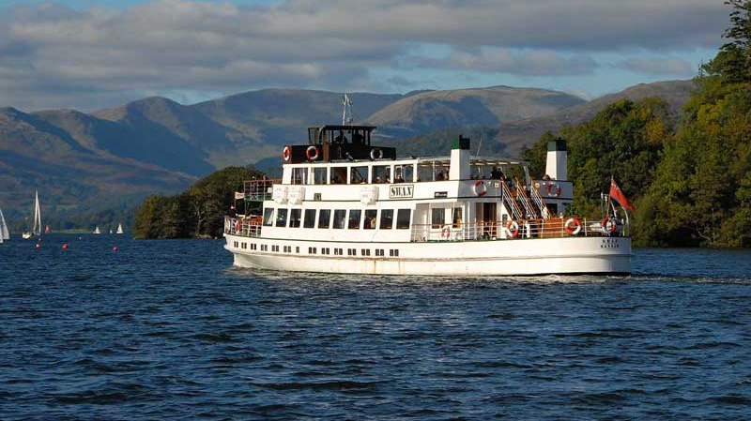
We want to see…

Slide 2
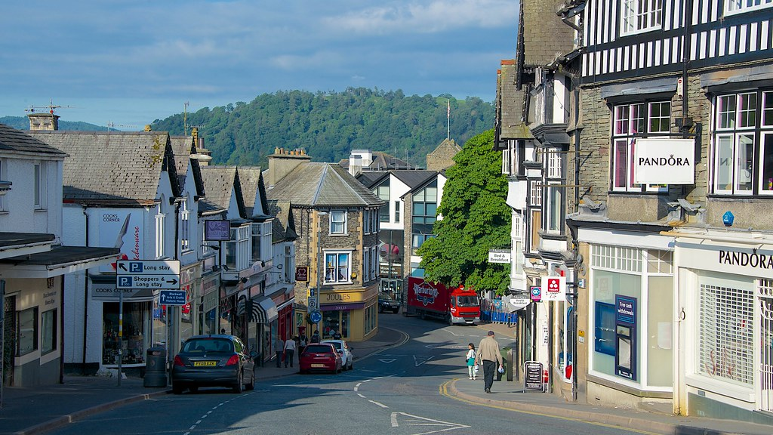
Thriving businesses

Slide 3
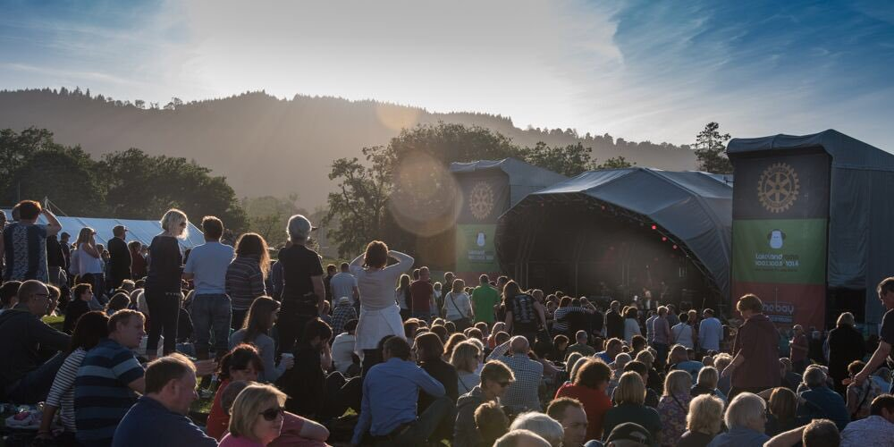
Events that bring people together

Slide 4
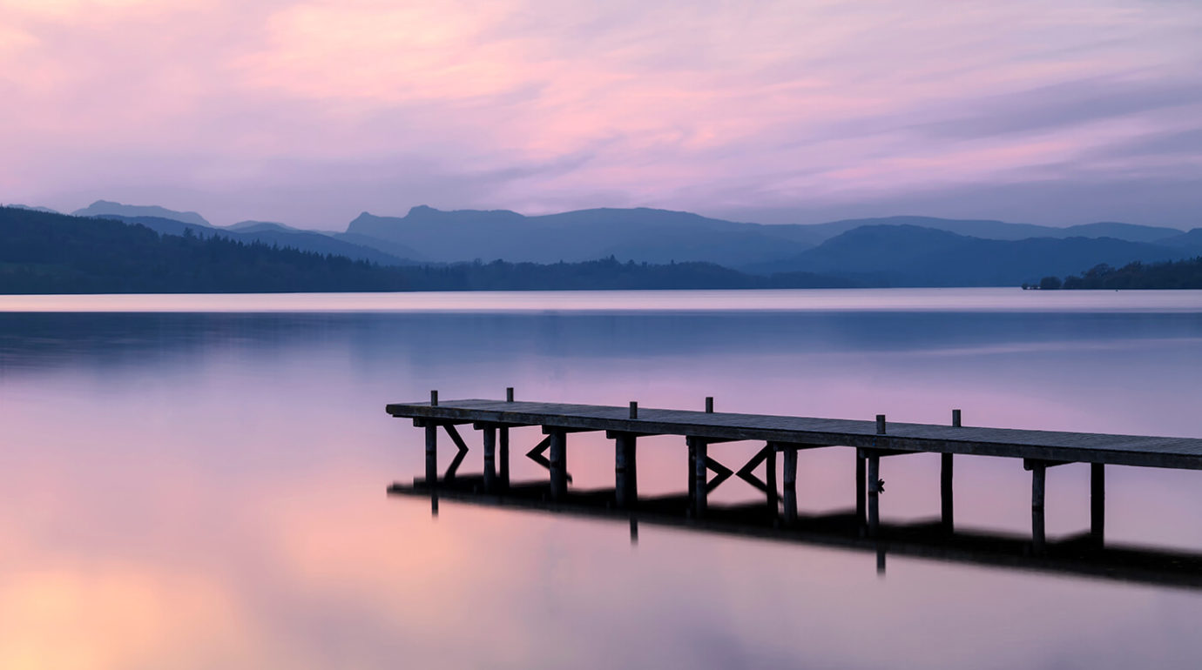
Landscapes that inspire forever…

Slide 5
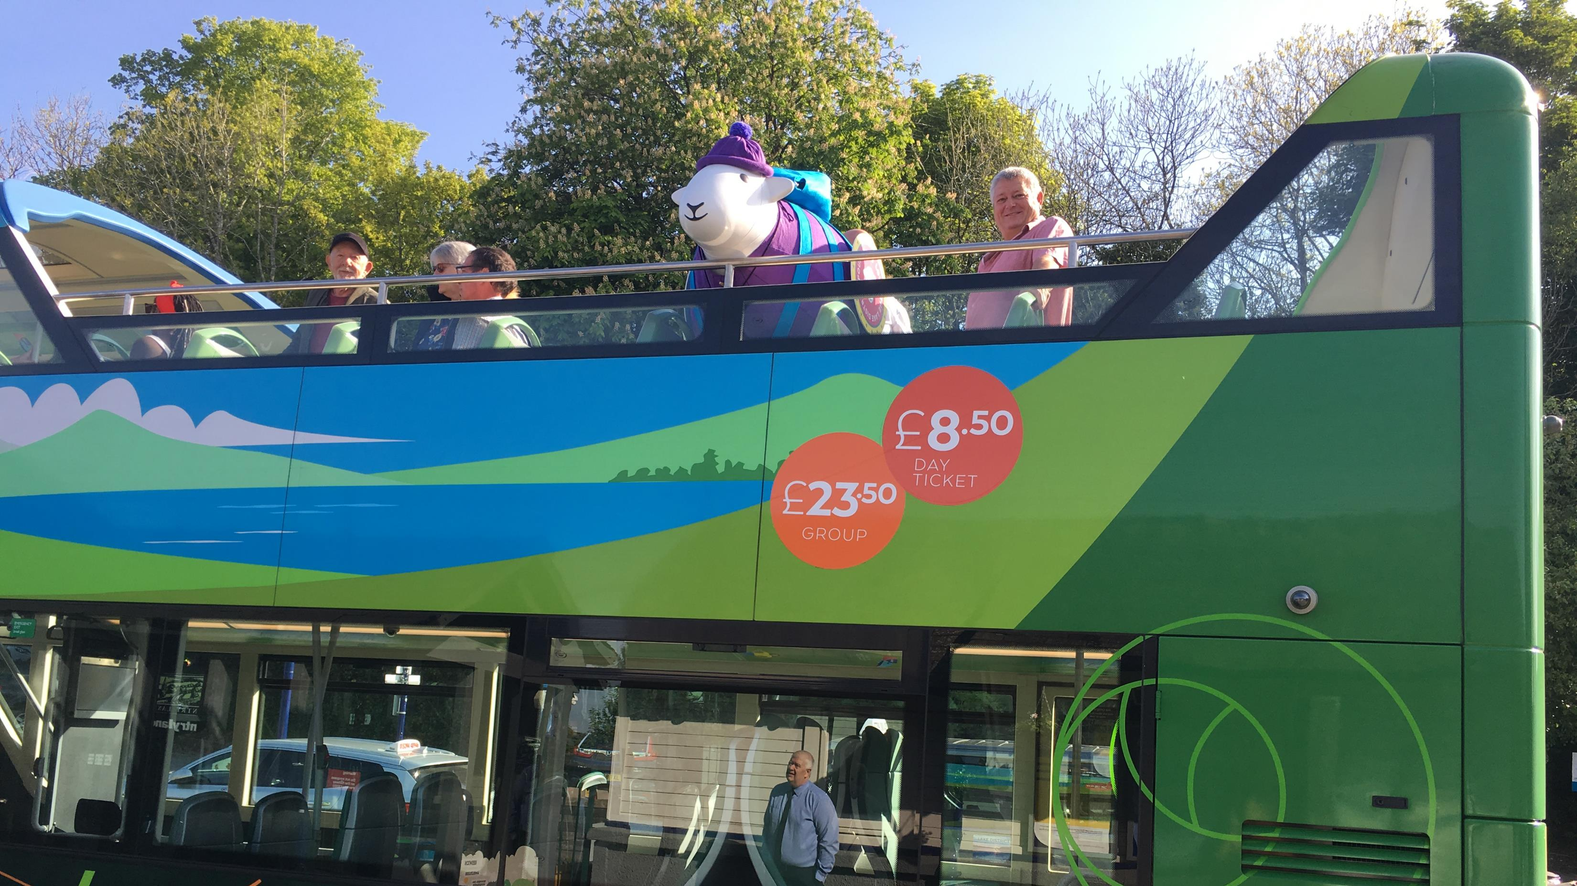
People staying longer and exploring more

Slide 6
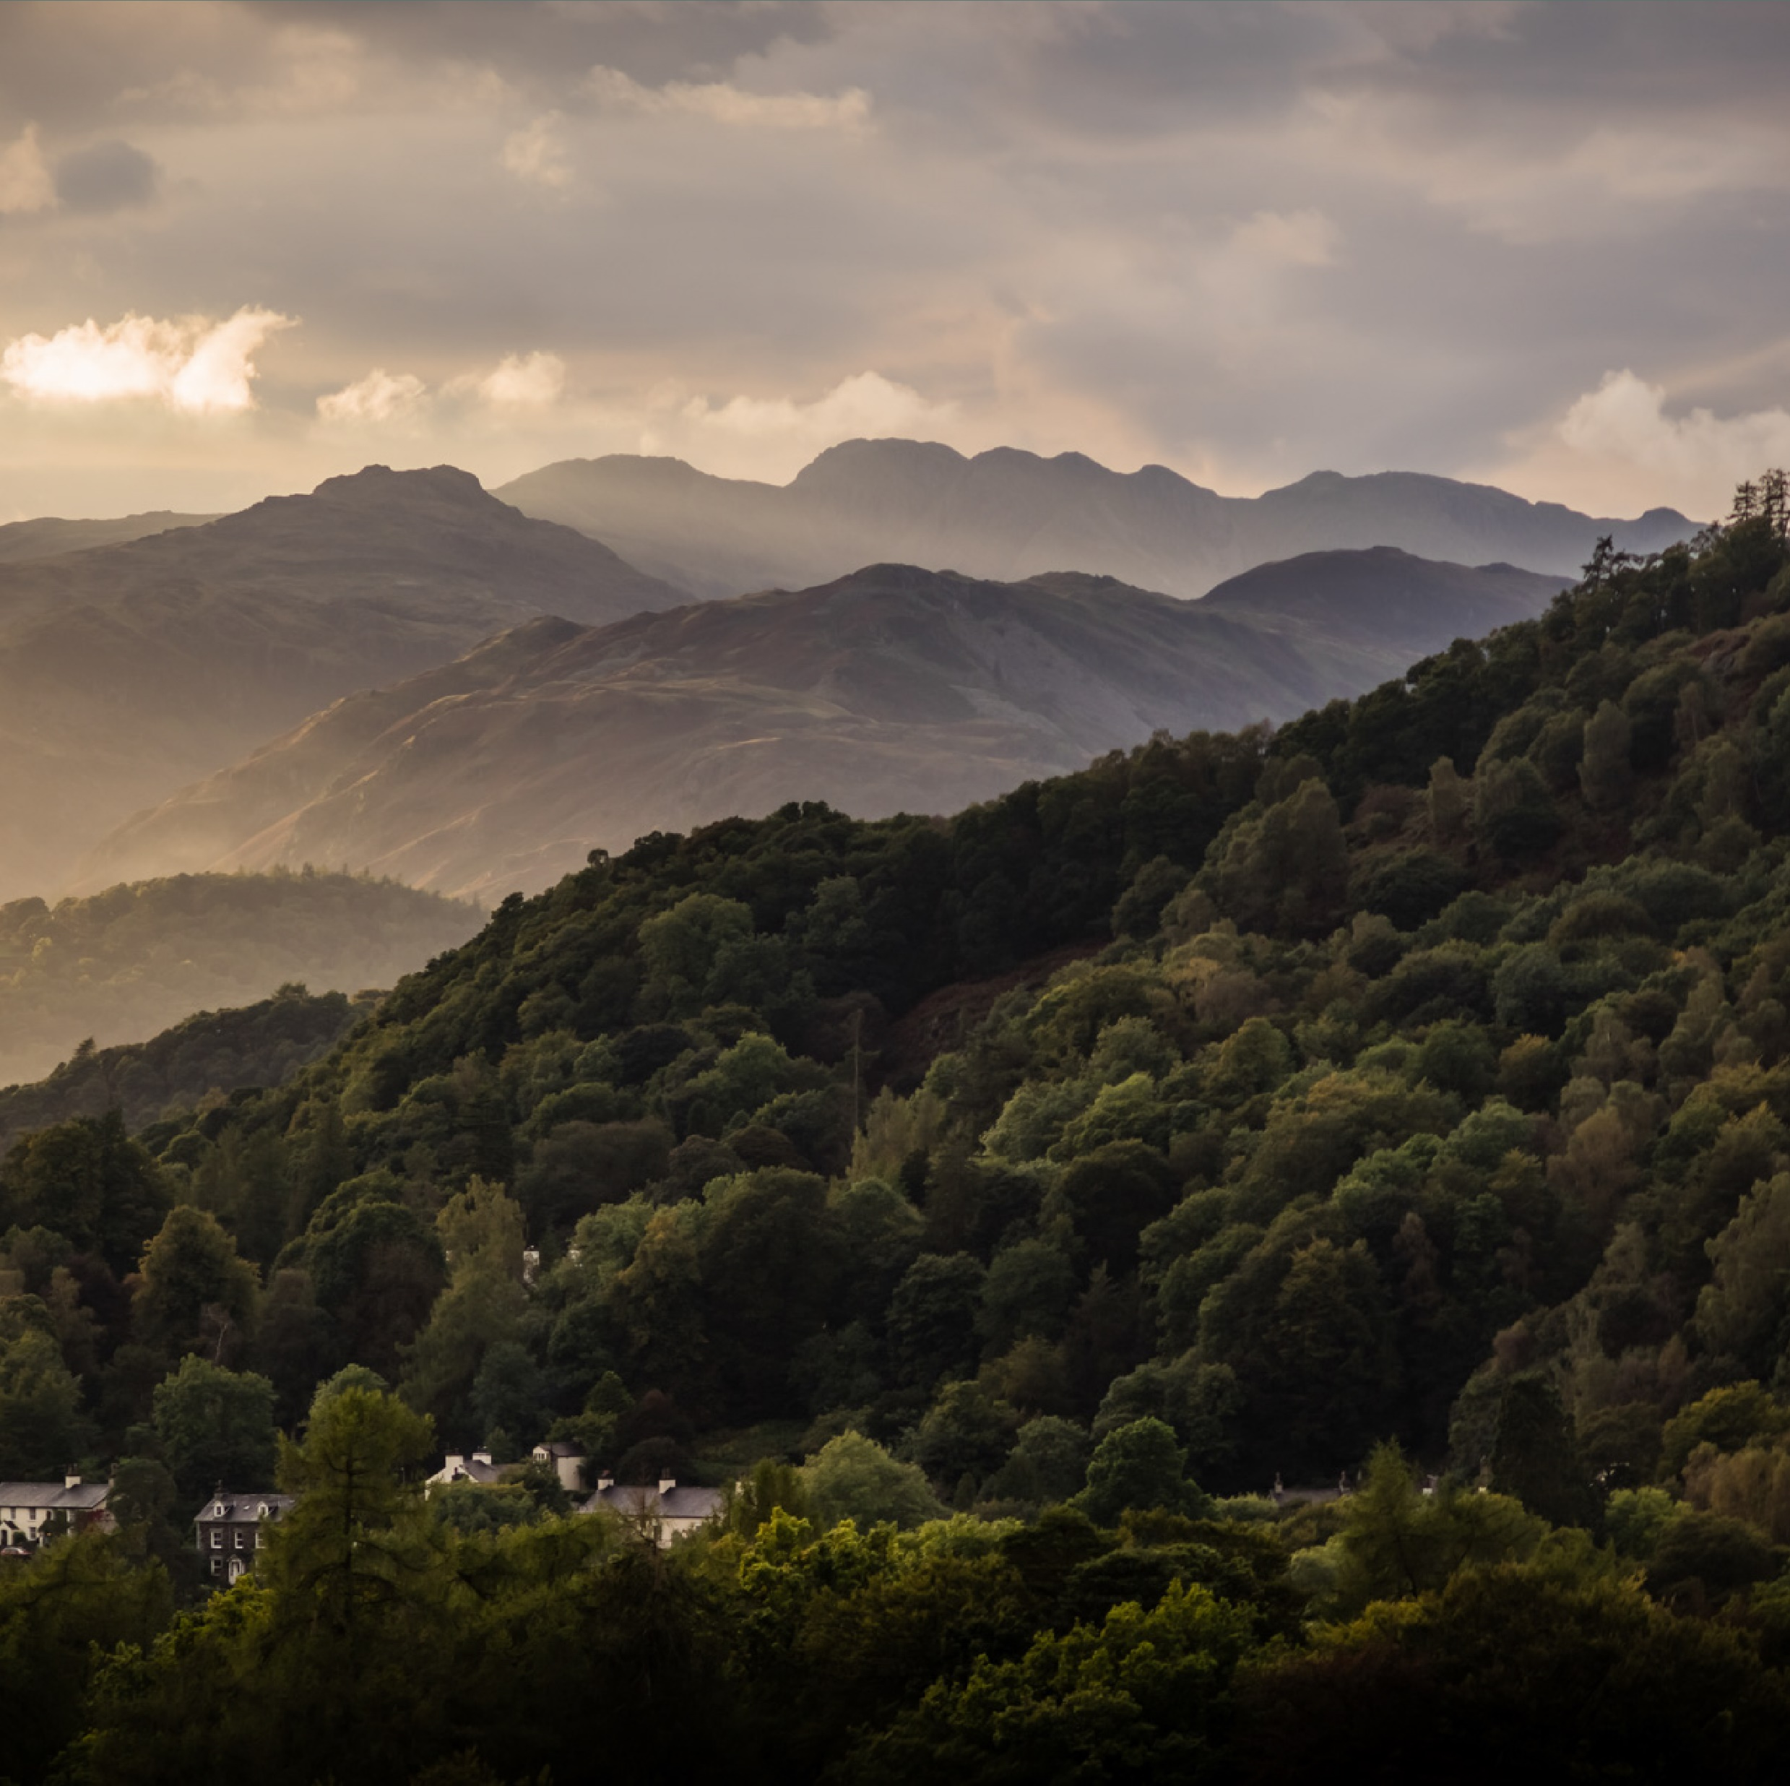
but we need your help
let’s work together

Slide 7
join us

Slide 9
Who are Bowness & Windermere Forward?
What is the purpose of Bowness & Windermere Forward?
A board of proactive representatives from the public, private and third sector.
To increase the economic prosperity and longevity of Bowness and Windermere.
Bowness & Windermere Forward is unique, there is no similar cross section board in Windermere or Bowness focusing entirely on the economic prosperity of the area.

Slide 10
Our roles are…

Slide 11
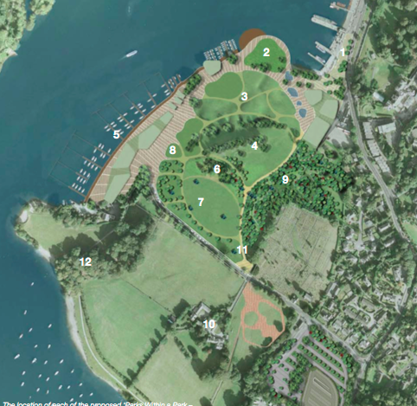
Public Realm Enhancers
BWF believe there are parts of Bowness and Windermere fall short of expectations associated with World Heritage Status
Identifying projects that fall between responsibility of board members.
Lobbying for improvements to be delivered quickly such as Cragbrow Roundabout
Delivering temporary projects to address immediate need.
Administering a grant scheme to enhance areas identified in the 2018 Grot Spot Survey.
Supporting existing local projects such as WBCOT window competition
Encourage long term thinking by being involved with key boards such as Windermere Gateway

Slide 12
Event Facilitators
BWF believe a strong events calendar supports economic growth by increasing dwell time, creating additional reasons to visit and increasing recommendations and referrals. They also provide opportunities to showcase local produce and culture as well as providing opportunities for local people to access cultural and enjoyable events in their local area.
BWF aim support local business and people who deliver and develop events by:
Encouraging events and out of season projects that fall between responsibility of board members.
Supporting existing local projects such as WBCOT window competition, Glebe Markets and more
Lobbying for reduced local authority fees (i.e. road closure)
Sharing contacts to reduce red tape challenges for those looking to put on events
Delivering events in partnership with others

Slide 13
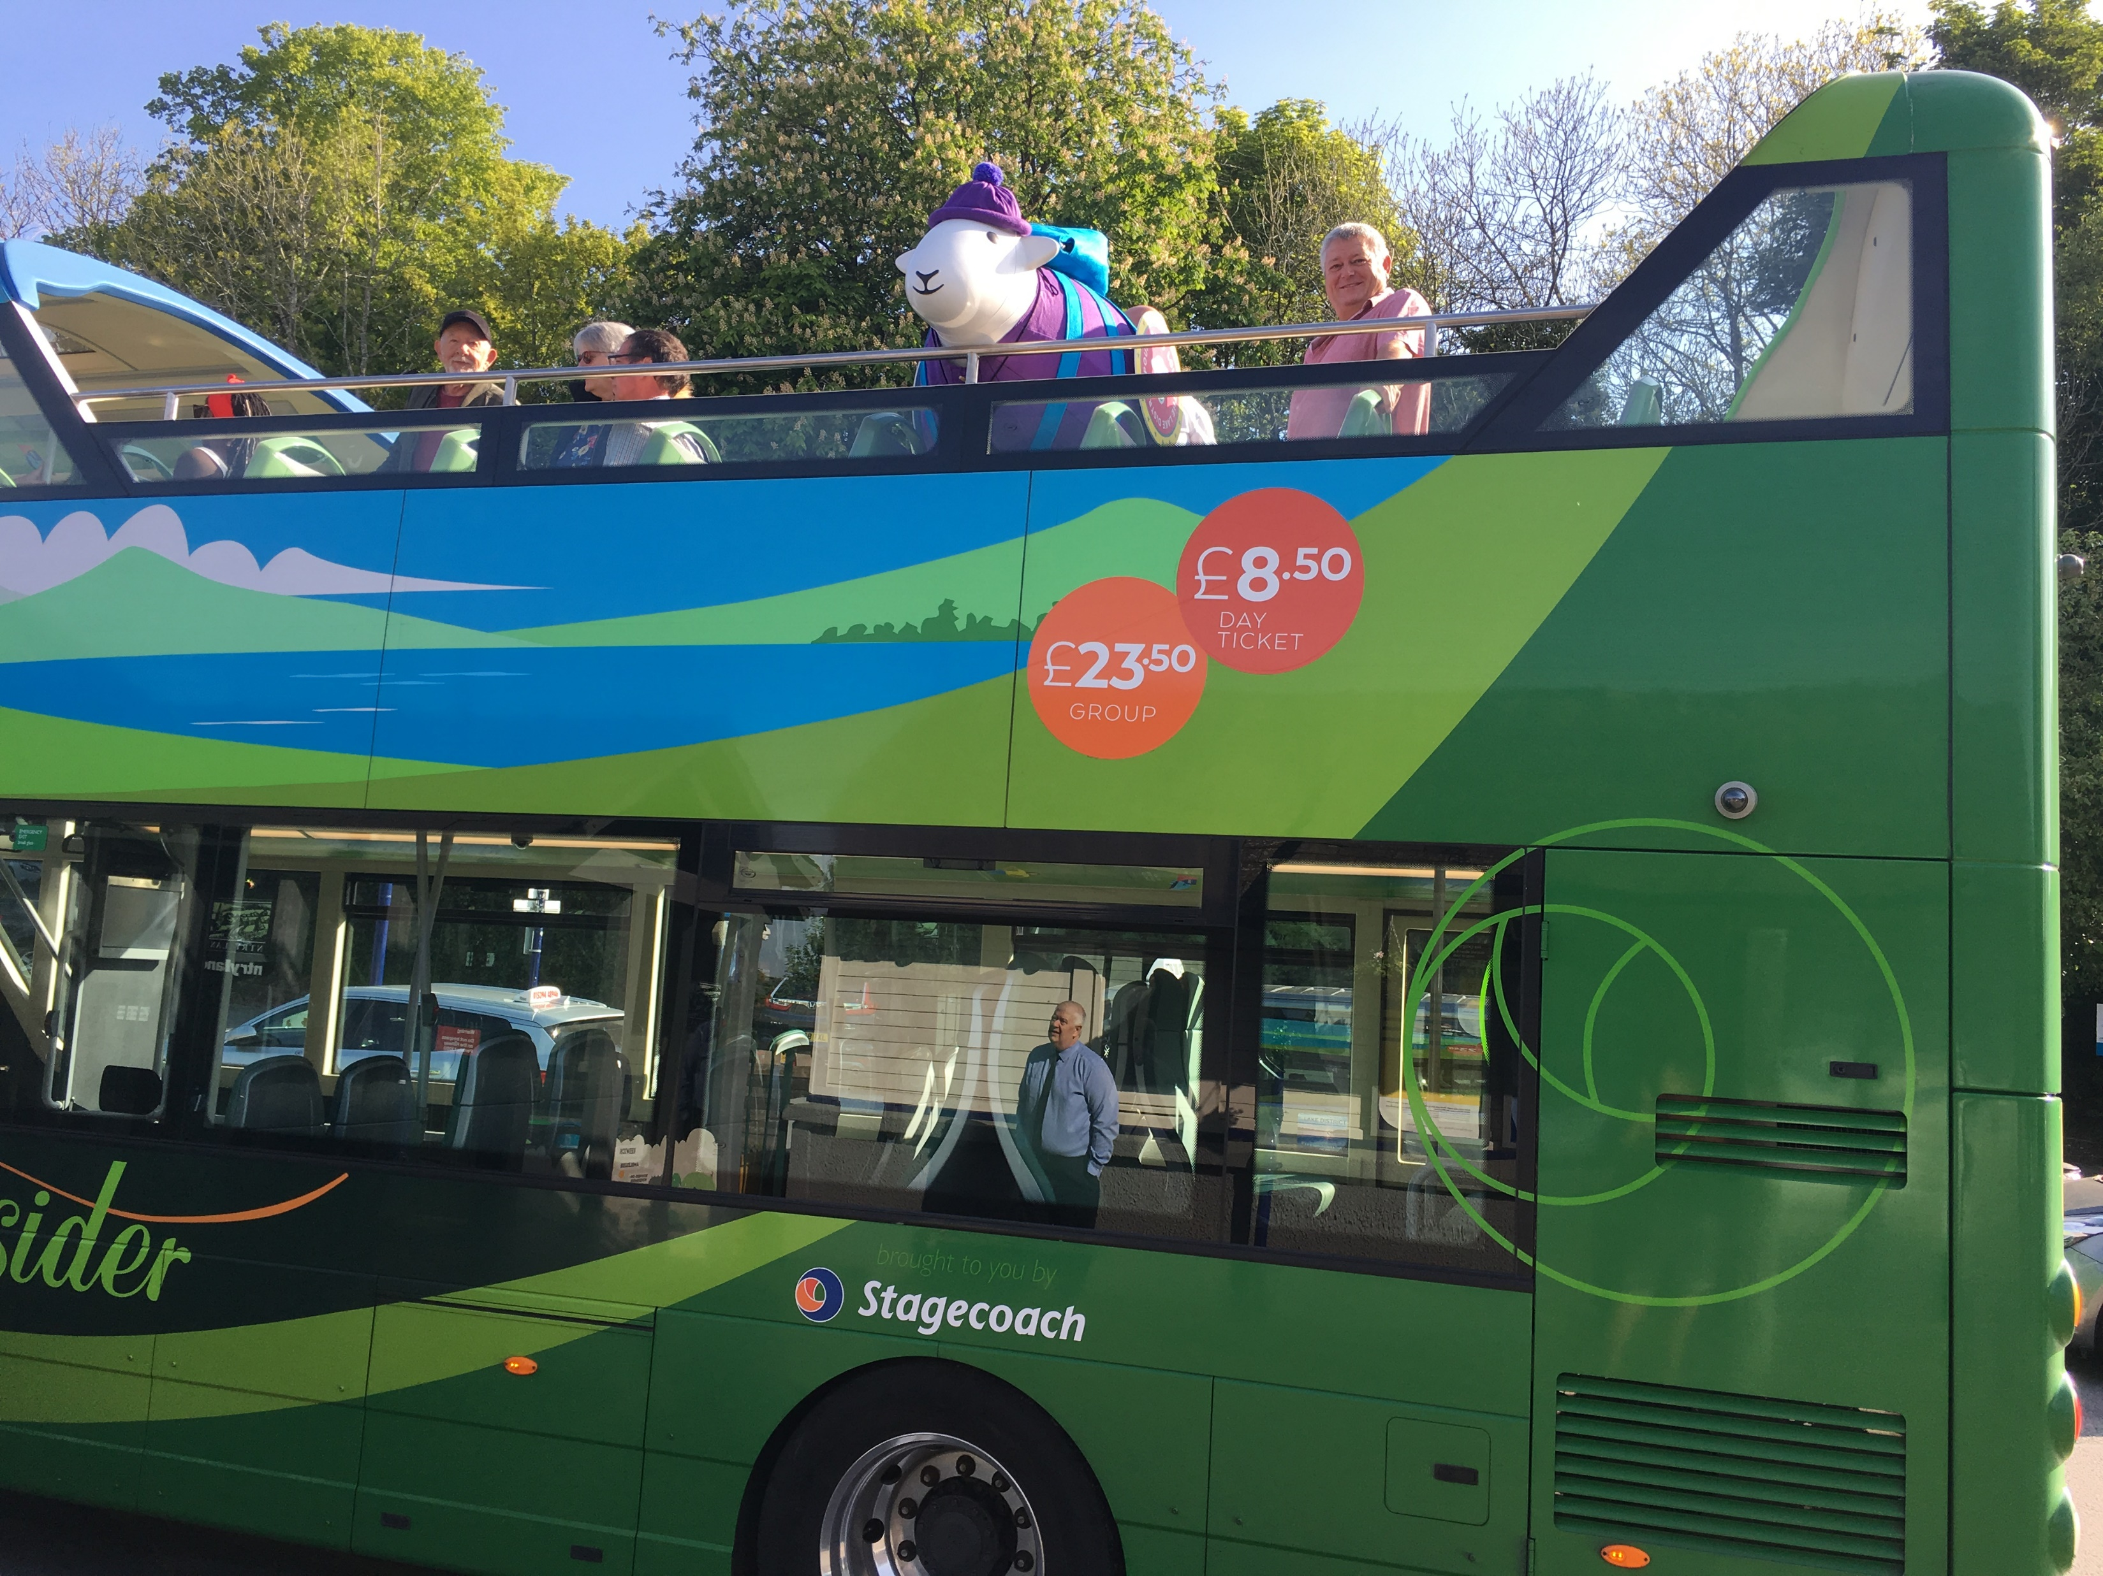
Sustainable Transport Lobbyists
BWF want to consider the long term sustainability of transport in our area. The future of transportation will look markedly different to today and as a board we aim to keep pace with changes and be ready for when they come. We support welcoming visitors to enjoy this area and recognise that at times there are parking issues which can create a more negative visitor and local experience therefore we will support sustainable solutions to resolve this.
BWF seek to improve sustainable transport by:
Lobbying for improvements to be delivered quickly i.e. bus stop enhancements, enhanced existing parking sites
Suggesting projects to local authority members regarding potential improvements
Campaigning for project delivery when necessary
Encouraging the use of other transport options via integration in all social media, event support and visitor directed marketing.
Support long term thinking, improved car parking and ambitious projects and represent the area in projects such as Windermere Gateway

Slide 14
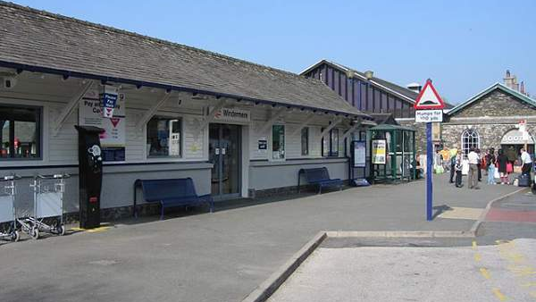
Visitor Economy Specialists
BWF recognise Bowness and Windermere has a thriving visitor economy and is dependant on tourism. We welcome tourism and visitors and want to encourage people to spend longer when they are here. Therefore BWF will in the main initiate and support projects that increase visitor dwell time, spend, referrals and recommendations by:
Welcoming visitors at key arrival points to enhance first impressions
Developing the Glebe Market and the Glebe with partners as an events space
Researching the need and potential positive impact of a ‘Welcome to Bowness and Windermere’ brand.
Considering potential brand outlets such as an app and website.
Securing funding to develop ‘Friendly Fells and Lakeside Trails’ a partner project to enhance and link the four green spaces and viewing points of Bowness and Windermere.
Supporting projects that seek to recognise the area as a conservation area.
Encouraging projects that support longer dwell time, in particular in the ‘shoulder seasons’

Slide 15
We will deliver…

Slide 16
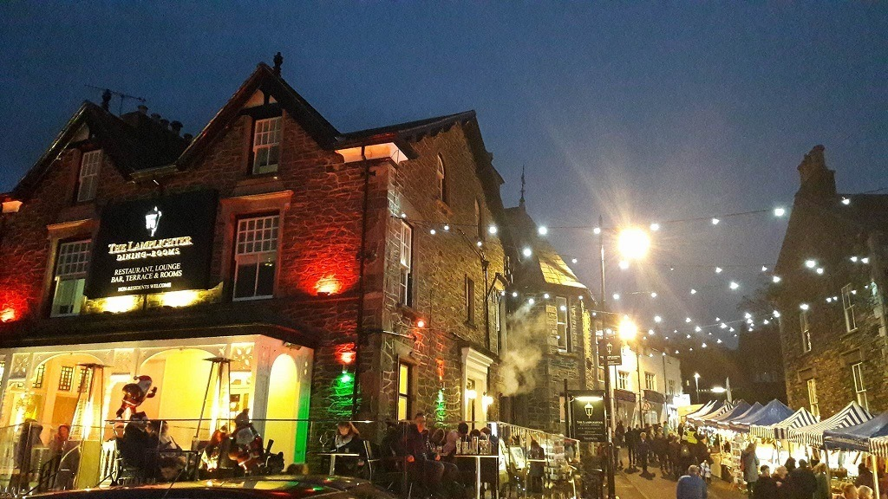
Public Realm
Research and develop waste improvements for Ash Street.
Clarify timescales for Cragbrow roundabout and instigate temporary enhancements if possible.
Consider a creative solution to remove the Swan mess @ The Glebe.
Administer the shop front enhancement grant scheme to enhance areas identified in the Grot Spot survey
Support the Windermere Gateway Project and report to the board so we can contribute to it
Visitor Economy Specialists
Develop the Welcome Volunteer programme with key partners – Windermere Tourist Info Centre
Research the need and potential impact of a ‘Welcome to Bowness and Windermere’ brand.
Research sustainable funding strategies for potential brand outlets such as an app and website including business led and crowd funding.
Secure National Lottery for Heritage funding to develop ‘Friendly Fells and Lakeside Trails’ a partner project to enhance and link the four green spaces and viewing points of Bowness and Windermere.

Slide 17
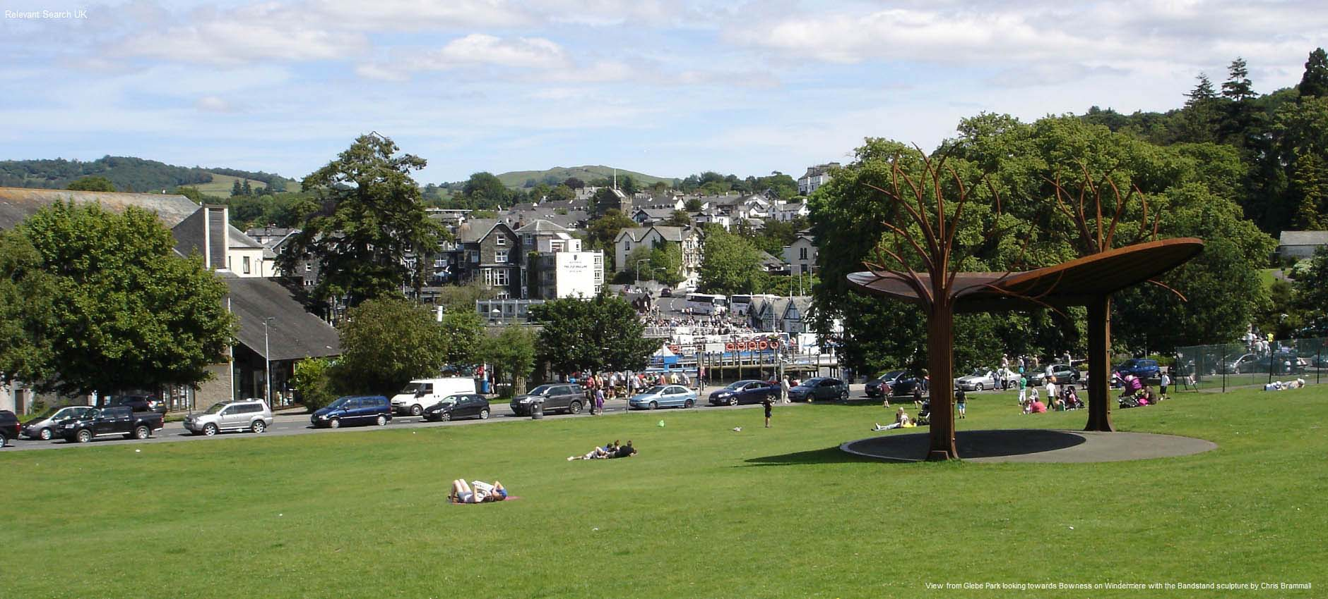
Event Facilitation and Support
Support the Glebe Market with promotion via monthly partner meetings and associated actions.
Promote event opportunities at Glebe Tennis Courts for other organisers
Produce an event criteria checklist to encourage local businesses and others to put on events.
Meet and encourage with existing event organisers – how can BWF help?
Sustainable Transport
Lobby and campaign for improvements including Rayrigg Road and Braithwaite Fold car park, bus stop enhancements, better coach parking and enhanced parking enforcement.
Highlight the ease of sustainable transport options via integration in all social media, event support and visitor directed marketing. Connect with Cumbria Tourism and other parties to do so.

Slide 18
Forward Together

Slide 19
Photo credits:
John Shedwick
Victoria Sedgwick
Bowness & Windermere in Days Gone By Facebook Page
Windermere Town Council
LDNPA
WTC

